Slide 1


Threat Intelligence Integration
with OpenCTI
SOC Analyst
Presented by: Ashogbon Ayomikun Abdulazeez

Slide 2

Project Overview
EXECUTIVE SUMMARY
Key Objectives
Context & Scope
Add threat intel layer to Wazuh
Integrate external CTI feeds
This project extended an existing SOC homelab environment by integrating OpenCTI as a dedicated Threat Intelligence Platform (TIP), driving enriched security telemetry and automated threat context.
Enrich alerts with IOC context
Check IPs, URLs, file hashes
Integrate MITRE ATT&CK intel
Apply CTI to detection rules
Project Goal
Move from simply detecting suspicious activity to understanding the threat intelligence associated with the indicators involved.

Slide 3
Existing SOC Environment
LAB BASELINE
Security Monitoring
Endpoints
Network Security
▹
Wazuh SIEM
▹
Windows VM with Sysmon
▹
pfSense Firewall
▹
Wazuh Manager
Ubuntu VM with Suricata
▹
▹
Wazuh Indexer
▹
Wazuh Dashboard
Existing Detection Rules
SSH brute-force detection
Suspicious process execution
Cron persistence
System service activity
Credential-related activity
Script interpreter activity
Key Point: The existing environment provided the telemetry and detection layer required for the OpenCTI integration.

Slide 4
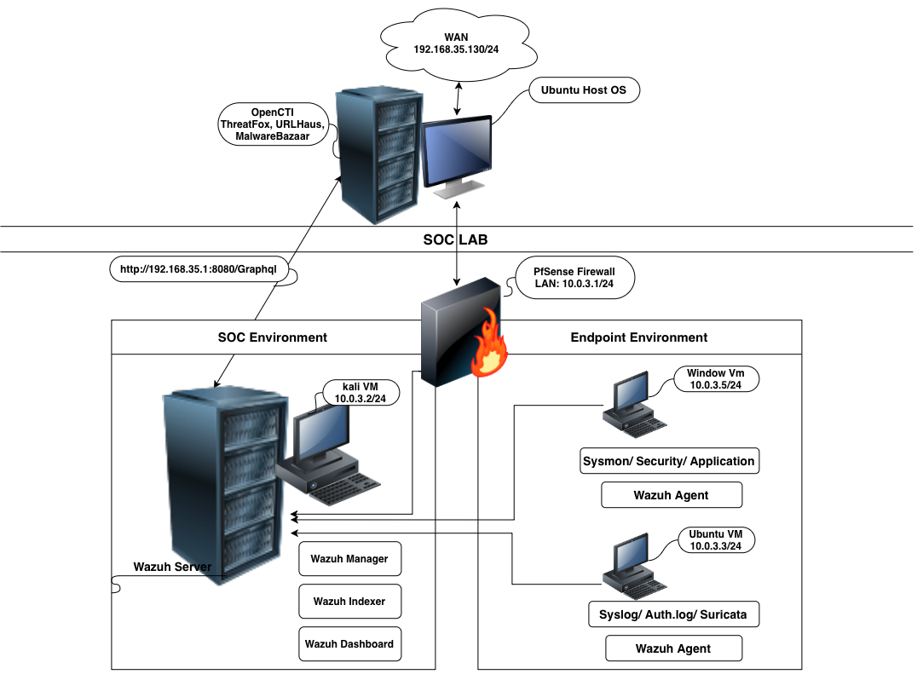
Completed Lab Architecture
PIPELINE & DATA FLOW
1
Threat Intelligence Feeds
URLhaus • MalwareBazaar • ThreatFox • MITRE ATT&CK
2
OpenCTI (Threat Intel Platform)
Correlates, structures, and manages IOCs & TTPs
3
Wazuh SIEM
Manager • Indexer • Dashboard
4
Security Telemetry Inputs
Windows + Sysmon • Ubuntu + Suricata • pfSense • Agents
Core Data Flow:
Endpoint Activity → Wazuh → OpenCTI IOC Lookup → Enriched Alert → Analyst

Slide 5
Phase 1 — Deploying OpenCTI
PLATFORM SETUP
Deployment
Platform Config
MITRE ATT&CK
▹
OpenCTI deployed using Docker Compose
▹
Analyst account created
▹
MITRE ATT&CK connector enabled
▹
Supporting services configured:
▹
OpenCTI data model explored
▹
ATT&CK information populated after troubleshooting
▹
Observables and Indicators reviewed
Elasticsearch
Redis
▹
Threat Actors, Campaigns, Malware, and Intrusion Sets explored
▹
Threat Actor and Indicator created manually
RabbitMQ
▹
Relationships between intelligence objects tested
MinIO

Slide 6
Phase 2 — External Threat Intelligence
FEED INTEGRATION
URLhaus
URLs / Infrastructure
MalwareBazaar
Hashes / Samples
▹
Malicious URLs
▹
Malware samples
▹
Malware distribution infrastructure
▹
File hashes
▹
Malware family information
ThreatFox
IOCs / C2
▹
IOC intelligence
▹
IP addresses
▹
Command-and-control infrastructure
Final Result: Three external threat intelligence feeds were successfully integrated and populated OpenCTI with usable intelligence.

Slide 7
Indicators Investigated
CTI SAMPLES
175.41.16.98
180.115.161.206
Malware Hash
SOURCE: THREATFOX
SOURCE: URLHAUS
SOURCE: MALWAREBAZAAR
▹
CobaltStrike
▹
Mozi / Mirai
▹
Score: 100/100
▹
botnet_cc
Associated with Remus loader
▹
ELF ARM malware distribution
▹
▹
Confirmed by Other Sources
▹
Active malware distribution point

Slide 8
Phase 3 — SIEM Threat Intelligence Enrichment
ENRICHMENT PIPELINE
Integration Method
GraphQL
Custom Wazuh–OpenCTI integration
Custom Wazuh rules
Enrichment Workflow
STEP 1
STEP 2
STEP 3
STEP 4
STEP 5
STEP 6
STEP 7
Wazuh detects event
IOC is identified
IOC sent to OpenCTI
OpenCTI searches intel
Match / context returned
Wazuh generates enriched alert
Analyst investigates alert
Key Result: The pipeline was event-driven rather than relying only on manual IOC lookups.

Slide 9
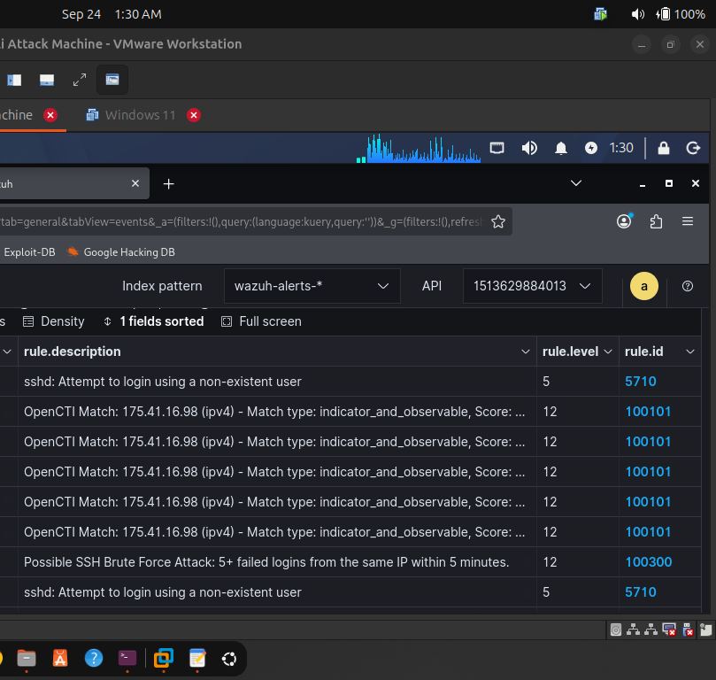

Integration Validation
TEST RESULTS
Negative Test
0 MATCHES
185.220.101.5
IOC:
Positive Test
MATCH FOUND
37.187.150.121
IOC:
Result: 1 match | Score: 80 | 7 associated indicators
Live Brute-Force Test
LIVE PIPELINE
175.41.16.98
IOC:
▹
Wazuh detected simulated activity
▹
OpenCTI processed IOC & returned context
[ INSERT DASHBOARD SCREENSHOTS ]
▹
Workflow was visible to the analyst
Key Finding: OpenCTI successfully added threat intelligence context to the existing Wazuh detection workflow.

Slide 10
Lessons Learned & Recommendations
KEY TAKEAWAYS
Lessons Learned
Recommendations
Integration Troubleshooting
1. Protect Integration Credentials
▹
MITRE ATT&CK required troubleshooting before ingestion
Secure API keys and tokens. Keep sensitive credentials out of shared configurations.
▹
MalwareBazaar required OpenCTI service address correction
2. Keep Alternative Threat Intel Sources
▹
AlienVault OTX replaced with ThreatFox due to connector issues
Maintain alternative feeds when a source becomes temporarily unavailable.
3. Maintain Regular Connector Health Checks
Monitoring & Debugging
Monitor feed ingestion continuously to identify connector failures early.
▹
Changing from integrator.debug=0 to 2 improved visibility
▹
Live event-driven processing successfully validated
Resource Management
▹
Limited RAM affected lab; used Ubuntu as light agent
▹
OpenCTI container memory limits were applied

Slide 11



THANK YOU!
Any Questions?
Ayomikun Ashogbon
LinkedIn: Ayomikun Ashogbon
Email: khayzed101@gmail.com
Phone: +234 7063612727

